Slide 2
differentiate between arithmetic and geometric progression,
compute general term and sum of ‘n’ terms of arithmetic and geometric progression,
analyze important points of arithmetic and geometric progression.

Slide 3

Sequence
Set of Numbers
Definite Order/Rule
${\text{\{}a_{n}\text{\} }= a}_{1}$, $a_{2}$, $a_{3},a_{4}$, ……, $a_{n}$
Finite - 1, 3, 5, 7, ……, 21
Infinite - 2, 4, 6, 8, 10, …..

Slide 4
Progression
Terms of a Sequence
Pattern
Examples
  3, 5, 7, 9, ..., 21
  1, 4, 9, 16, ...
  8, 5, 2, - 1, - 4, ...

Slide 5
Series
Sequence - Numbers
Numbers – Terms - Predefined Rule
Specific Pattern
Adding/Subtracting - Terms of a Sequence
Examples
  3 + 5 + 7 + 9 + ... + 21
  1 + 4 + 9 + 16 + ...
  8 + 5 + 2 + (- 1) + ...

Slide 6
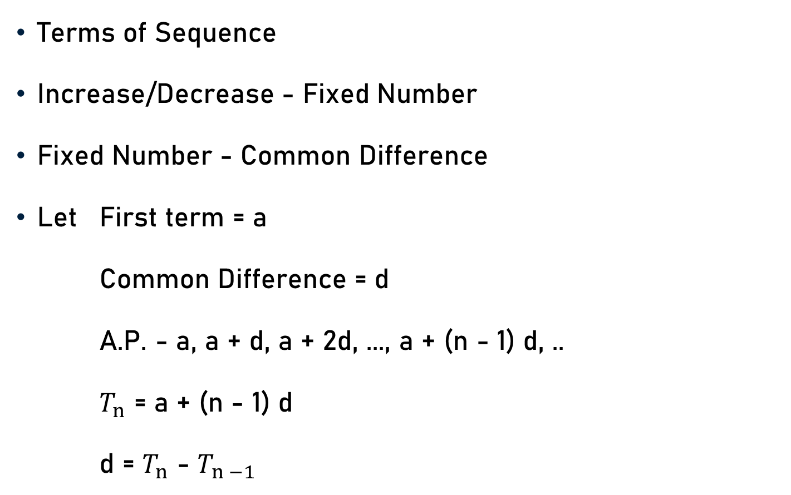
Arithmetic Progression (A. P.)
Terms of Sequence
Increase/Decrease - Fixed Number
Fixed Number - Common Difference
Let First term = a
Common Difference = d
A.P. - a, a + d, a + 2d, ..., a + (n - 1) d, ..
$T_{n}$ = a + (n - 1) d
d = $T_{n}$ - $T_{n −1}$

Slide 7
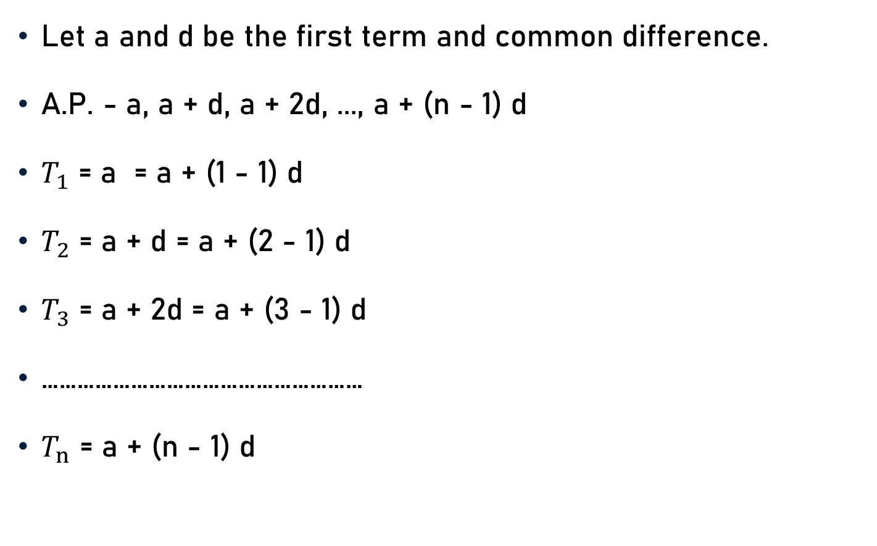
General Term – A. P.
Let a and d be the first term and common difference.
A.P. - a, a + d, a + 2d, ..., a + (n - 1) d
$T_{1}$ = a = a + (1 - 1) d
$T_{2}$ = a + d = a + (2 - 1) d
$T_{3}$ = a + 2d = a + (3 - 1) d
………………………………………………
$T_{n}$ = a + (n - 1) d

Slide 8
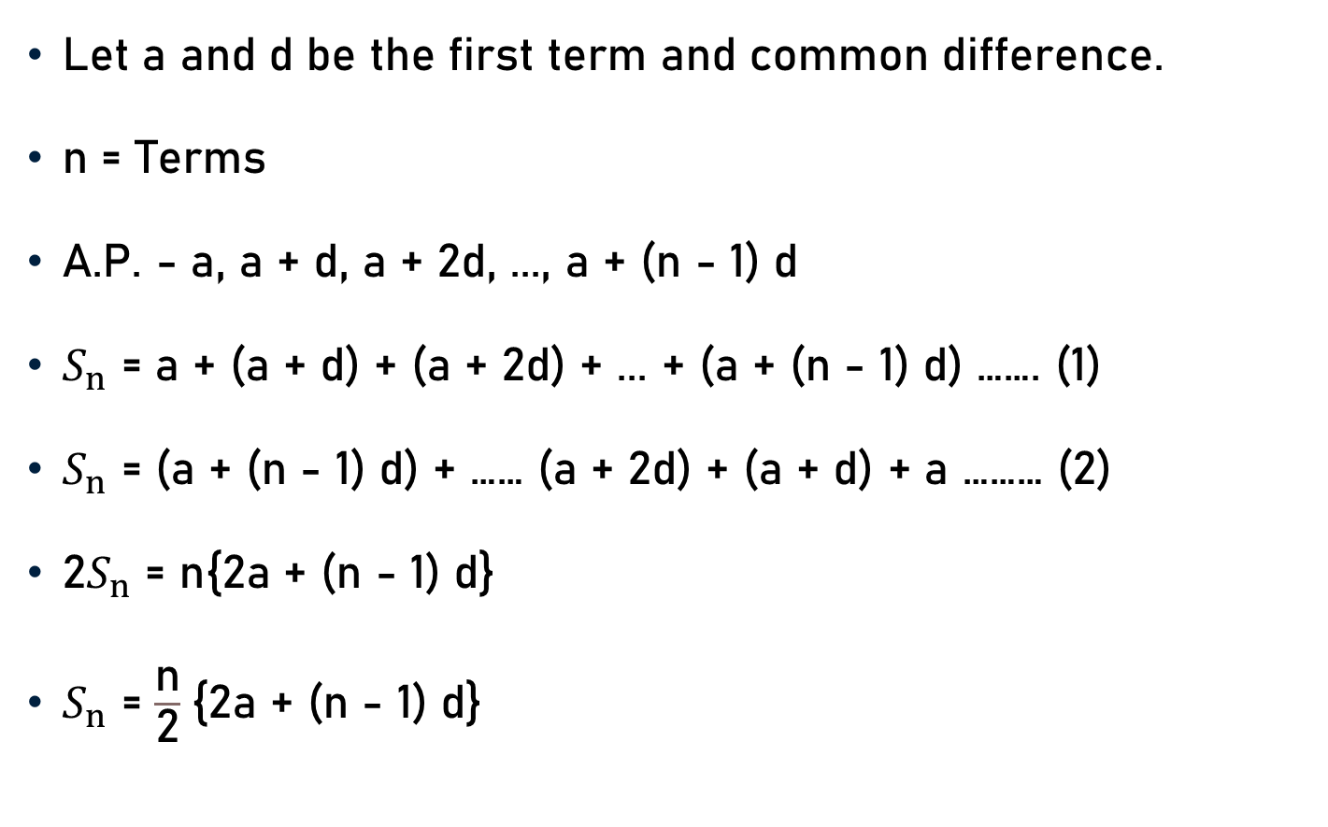
Sum of ‘n’ Terms– A. P.
Let a and d be the first term and common difference.
n = Terms
A.P. - a, a + d, a + 2d, ..., a + (n - 1) d
$S_{n}$ = a + (a + d) + (a + 2d) + ... + (a + (n - 1) d) ……. (1)
$S_{n}$ = (a + (n - 1) d) + …… (a + 2d) + (a + d) + a ……… (2)
2$S_{n}$ = n{2a + (n - 1) d}
$S_{n}$ = $\frac{\text{n}}{\text{2}}${2a + (n - 1) d}

Slide 9
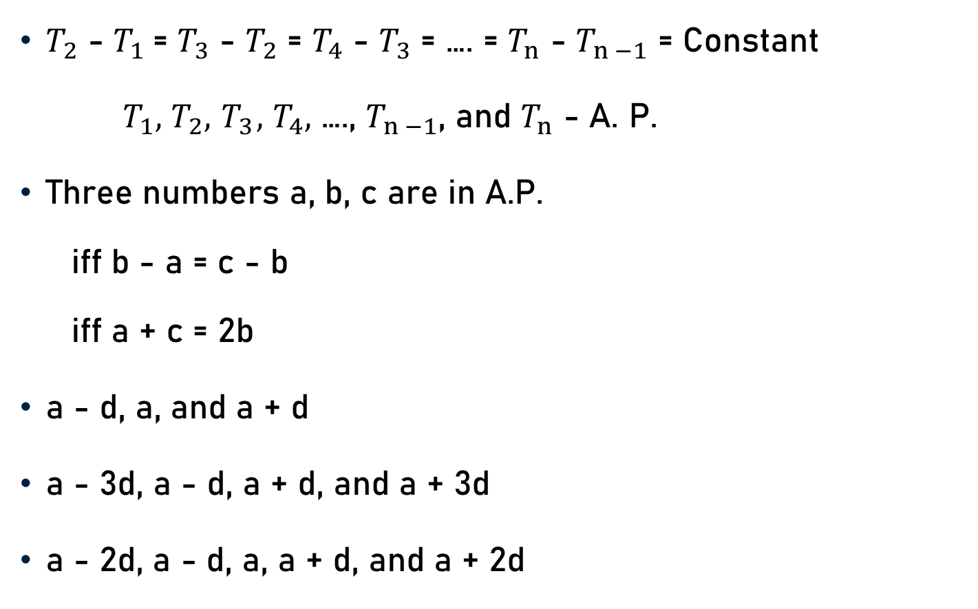
Important Points – A. P.
$T_{2}$ - $T_{1}$= $T_{3}$ - $T_{2}$ = $T_{4}$ - $T_{3}$ = …. = $T_{n}$ - $T_{n −1}$ = Constant
$T_{1},$ $T_{2}, { T}_{3},$ $T_{4},$ …., $T_{n −1}$, and $T_{n}$ - A. P.
Three numbers a, b, c are in A.P.
  iff b - a = c - b
  iff a + c = 2b
a - d, a, and a + d
a - 3d, a - d, a + d, and a + 3d
a - 2d, a - d, a, a + d, and a + 2d

Slide 10
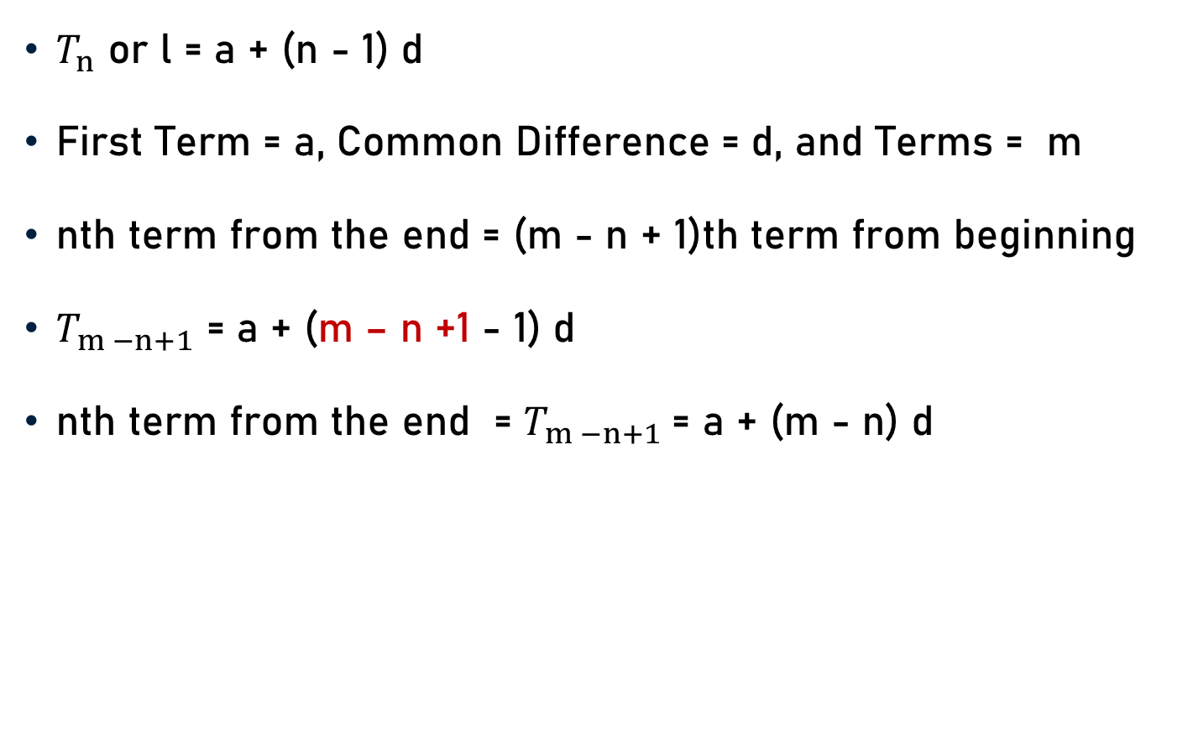
Important Points – A. P.
$T_{n}$ or l = a + (n - 1) d
First Term = a, Common Difference = d, and Terms = m
nth term from the end = (m - n + 1)th term from beginning
$T_{m −n+1}$ = a + (m – n +1 - 1) d
nth term from the end = $T_{m −n+1}$= a + (m - n) d

Slide 11

Important Points – A. P.
$T_{n}\text{ =} S_{n} \text{−}S_{n −1}$
$S_{n}$ = $\frac{\text{n}}{\text{2}}${2a + (n - 1) d}
  $S_{n}$ = $\frac{\text{n}}{\text{2}}${a + [a + (n - 1) d]}
  $S_{n}$ = $\frac{\text{n}}{\text{2}}${a + l}
  (Because $T_{n}$ or l = a + (n - 1) d)
  $S_{n}$ = $\frac{\text{n}}{\text{2}}${a + l}

Slide 12

Important Points – A. P.
$S_{n}$ = $\frac{\text{n}}{\text{2}}${a + l}
$S_{n}$ = $\frac{\text{n}}{\text{2}}${a + (n - 1) d - (n - 1) d + l}
$S_{n}$ = $\frac{\text{n}}{\text{2}}${l - (n - 1) d + l}
(Because l = a + (n - 1) d)
$S_{n}$ = $\frac{\text{n}}{\text{2}}$ [2l - (n - 1) d]

Slide 13
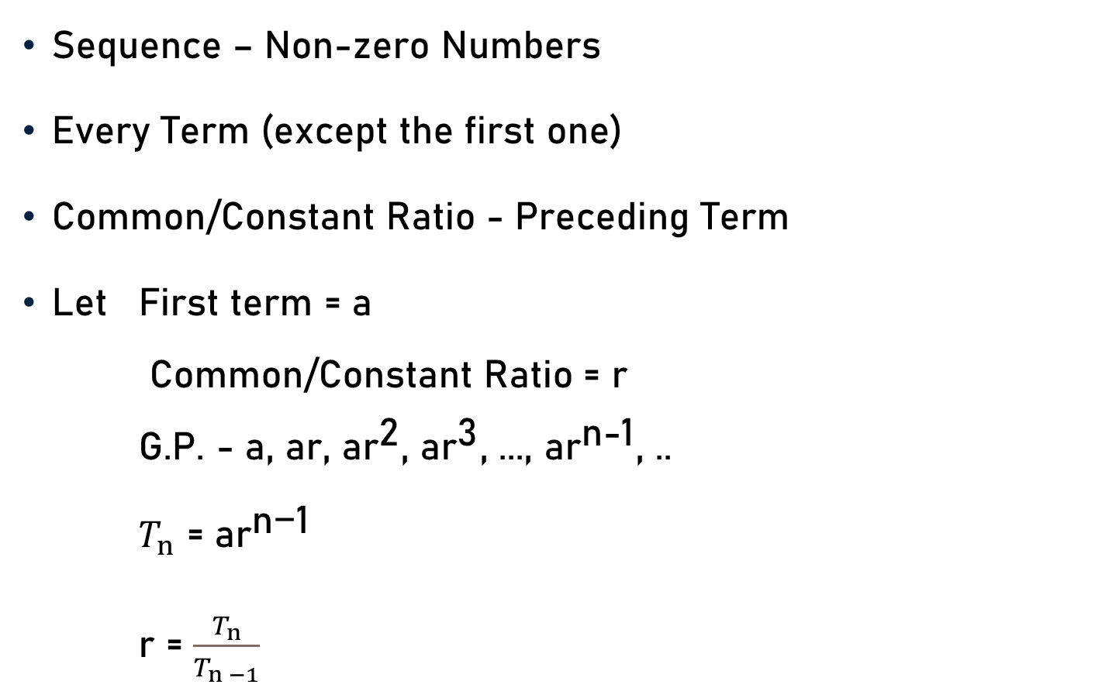
Geometeric Progression (G. P.)
Sequence – Non-zero Numbers
Every Term (except the first one)
Common/Constant Ratio - Preceding Term
Let First term = a
Common/Constant Ratio = r
G.P. - a, ar, a${\text{r}}^{\text{2}}$, a${\text{r}}^{\text{3}}$, ..., a${\text{r}}^{\text{n}\text{−1}}$, ..
$T_{n}$ = a${\text{r}}^{\text{n}\text{−1}}$
r = $\frac{T_{n}}{T_{n −1}}$

Slide 14

General Term – G. P.
Let a and r be the first term and common ratio.
G.P. - a, ar, a${\text{r}}^{\text{2}}$, a${\text{r}}^{\text{3}}$, ..., a${\text{r}}^{\text{n}\text{−1}}$
$T_{1}$ = a = a${\text{r}}^{\text{0}}$ = a${\text{r}}^{\text{1 − 1}}$
$T_{2}$ = a${\text{r}}^{\text{1}}$ = a${\text{r}}^{\text{2}\text{ − 1}}$
$T_{3}$ = a${\text{r}}^{\text{2}}$ = a${\text{r}}^{\text{3}\text{ − 1}}$
………………………………………………
$T_{n}$ = a${\text{r}}^{\text{n}\text{−1}}$

Slide 15
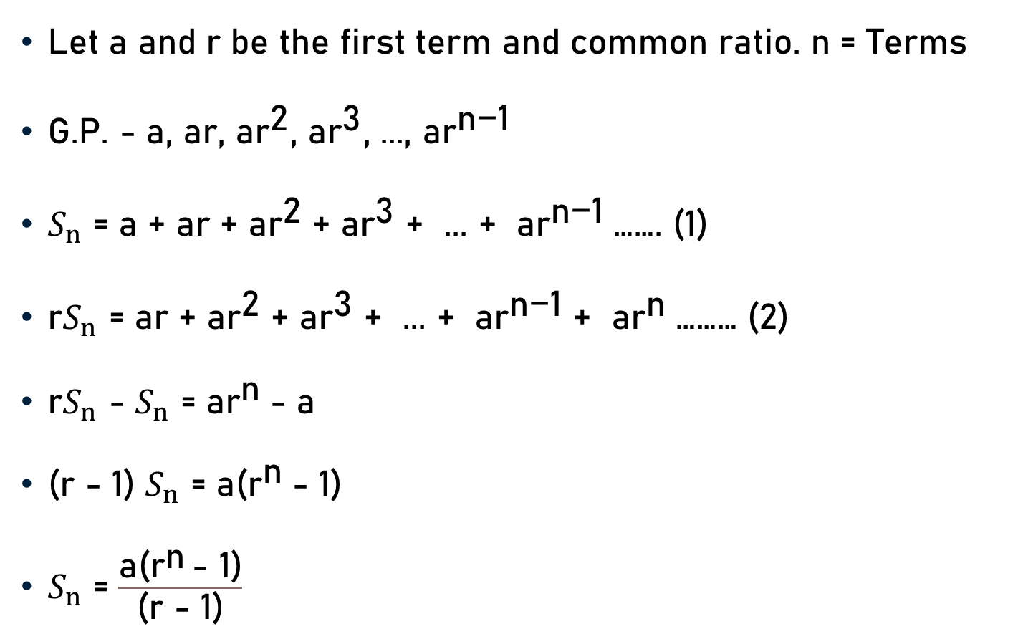
Sum of ‘n’ Terms– G. P.
Let a and r be the first term and common ratio. n = Terms
G.P. - a, ar, a${\text{r}}^{\text{2}}$, a${\text{r}}^{\text{3}}$, ..., a${\text{r}}^{\text{n}\text{−1}}$
$S_{n}$ = a + ar + a${\text{r}}^{\text{2}}$ + a${\text{r}}^{\text{3}}$ + ... + a${\text{r}}^{\text{n}\text{−1}}$……. (1)
${\text{r}S}_{n}$ = ar + a${\text{r}}^{\text{2}}$ + a${\text{r}}^{\text{3}}$ + ... + a${\text{r}}^{\text{n}\text{−1}}$ + a${\text{r}}^{\text{n}}$……… (2)
${\text{r}S}_{n}$ - $S_{n}$ = a${\text{r}}^{\text{n}}$- a
(r - 1) $S_{n}$ = a(${\text{r}}^{\text{n}}$- 1)
$S_{n}$ = $\frac{\text{a}\text{(}{\text{r}}^{\text{n}} \text{− 1)}}{\text{(}\text{r}\text{ − 1)}}$

Slide 16
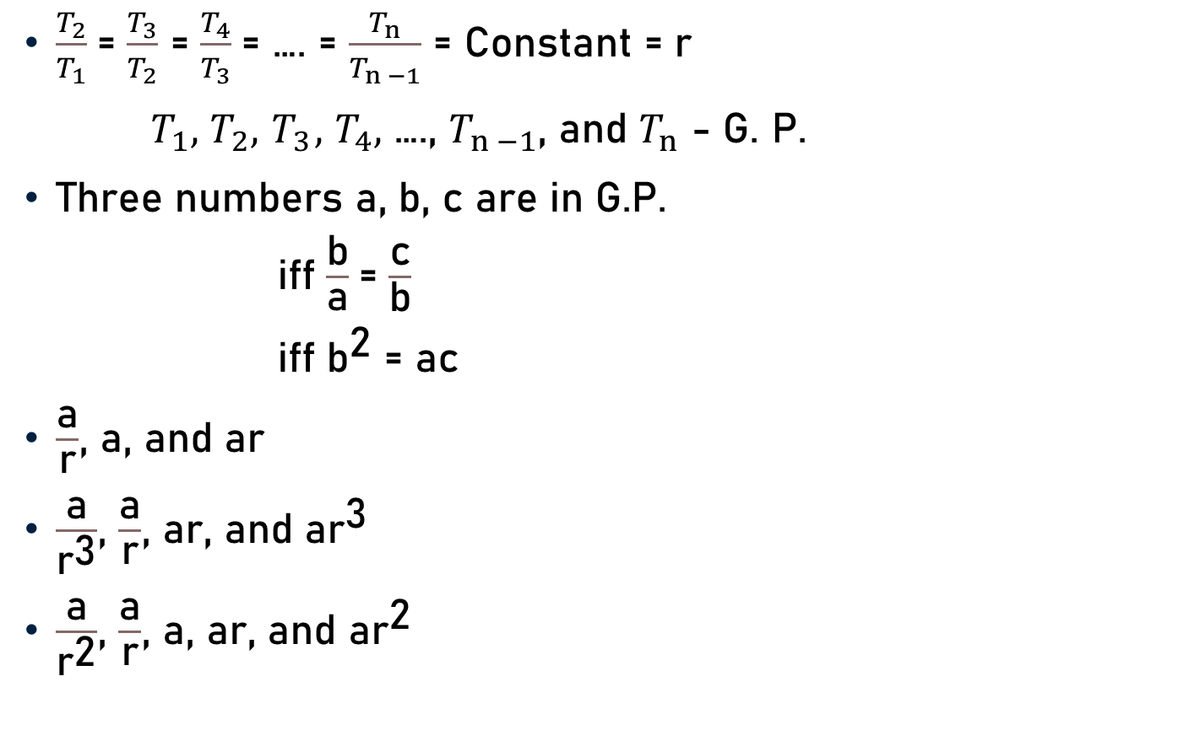
Important Points – G. P.
$\frac{T_{2}}{T_{1}}$= $\frac{T_{3}}{T_{2}}$ = $\frac{T_{4}}{T_{3}}$= …. = $\frac{T_{n}}{T_{n −1}}$ = Constant = r
$T_{1},$ $T_{2}, { T}_{3},$ $T_{4},$ …., $T_{n −1}$, and $T_{n}$ - G. P.
Three numbers a, b, c are in G.P.
  iff $\frac{\text{b}}{\text{a}}$= $\frac{\text{c}}{\text{b}}$
  iff ${\text{b}}^{\text{2}}$ = ac
$\frac{\text{a}}{\text{r}}$, a, and ar
$\frac{\text{a}}{{\text{r}}^{\text{3}}}$, $\frac{\text{a}}{\text{r}}$, ar, and a${\text{r}}^{\text{3}}$
$\frac{\text{a}}{{\text{r}}^{\text{2}}}$, $\frac{\text{a}}{\text{r}}$, a, ar, and a${\text{r}}^{\text{2}}$

Slide 17
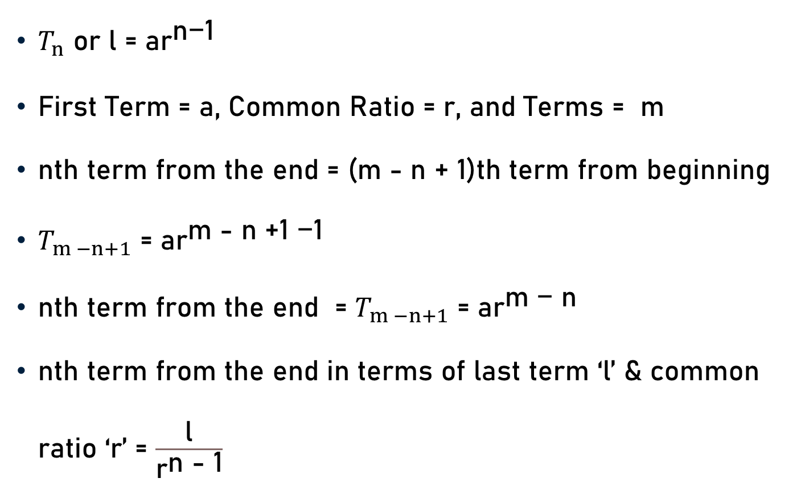
Important Points – G. P.
$T_{n}$ or l = a${\text{r}}^{\text{n}\text{−1}}$
First Term = a, Common Ratio = r, and Terms = m
nth term from the end = (m - n + 1)th term from beginning
$T_{m −n+1}$ = a${\text{r}}^{\text{m}\text{ − }\text{n}\text{ +1 −1}}$
nth term from the end = $T_{m −n+1}$ = a${\text{r}}^{\text{m}\text{ − }\text{n}}$
nth term from the end in terms of last term ‘l’ & common ratio ‘r’ = $\frac{\text{l}}{{\text{r}}^{\text{n}\text{ − 1}}}$

Slide 18
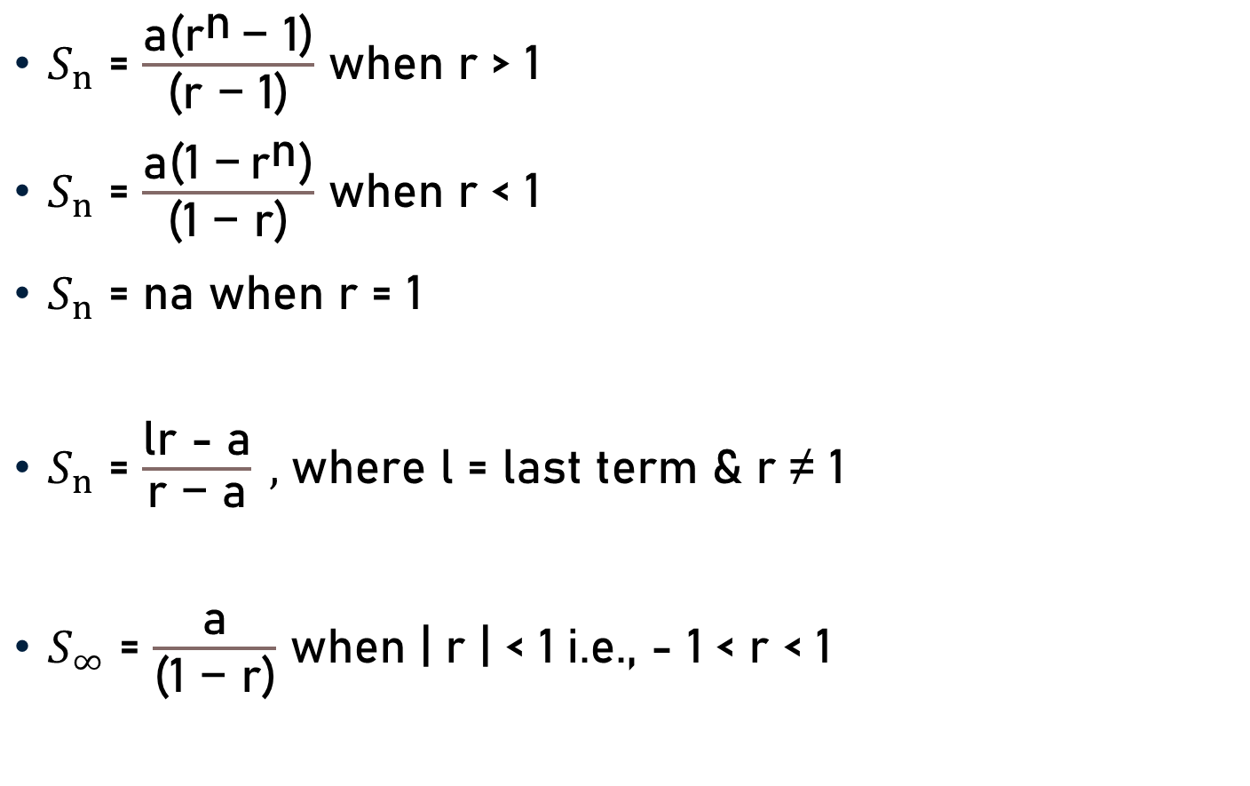
Important Points – G. P.
$S_{n}$ = $\frac{\text{a}\text{(}{\text{r}}^{\text{n}} \text{− 1)}}{\text{(}\text{r}\text{ − 1)}}$ when r > 1
$S_{n}$ = $\frac{\text{a}\text{(1 −} {\text{r}}^{\text{n}}\text{)}}{\text{(}\text{1}\text{ − }\text{r}\text{)}}$ when r < 1
$S_{n}$ = na when r = 1
$S_{n}$ = $\frac{\text{lr}\text{ − }\text{a}}{\text{r}\text{ − }\text{a}} ,$where l = last term & r ≠ 1
$S_{∞}$ = $\frac{\text{a}}{\text{(1 − }\text{r}\text{)}}$ when | r | < 1 i.e., - 1 < r < 1

Slide 19
Conclusion
Progression
  Terms of a Sequence (Pattern)
Arithmetic Progression
  Terms of Sequence
  Increase/Decrease - Fixed Number
Geometric Progression
  Sequence – Non-zero Numbers
  Every Term (except the first one)
  Common/Constant Ratio - Preceding Term

Slide 20

Conclusion
Arithmetic Progression
  d = $T_{n}$ - $T_{n −1}$
  $T_{n}$ = a + (n - 1) d
  $S_{n}$ = $\frac{\text{n}}{\text{2}}${2a + (n - 1) d}

Slide 21
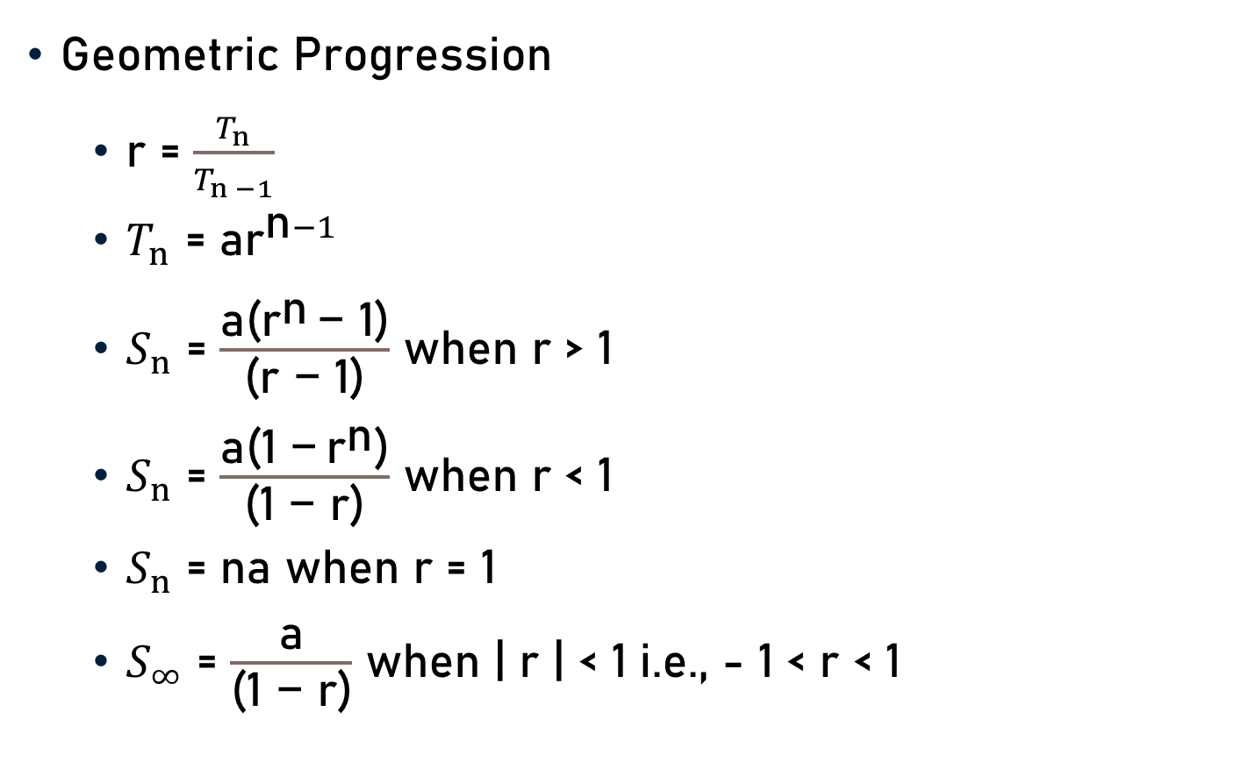
Conclusion
Geometric Progression
  r = $\frac{T_{n}}{T_{n −1}}$
  $T_{n}$ = a${\text{r}}^{\text{n}−1}$
  $S_{n}$ = $\frac{\text{a}\text{(}{\text{r}}^{\text{n}} \text{− 1)}}{\text{(}\text{r}\text{ − 1)}}$ when r > 1
  $S_{n}$ = $\frac{\text{a}\text{(1 −} {\text{r}}^{\text{n}}\text{)}}{\text{(1 − }\text{r}\text{)}}$ when r < 1
  $S_{n}$ = na when r = 1
  $S_{∞}$ = $\frac{\text{a}}{\text{(1 − }\text{r}\text{)}}$ when | r | < 1 i.e., - 1 < r < 1

Slide 22
Summary
Progression
Arithmetic Progression
Geometric Progression

